Slide 1
PASIFIKA PIKOPOLO
2ND ANNUAL
2026 Pickleball Tournament
Sponsorship Deck

Slide 2

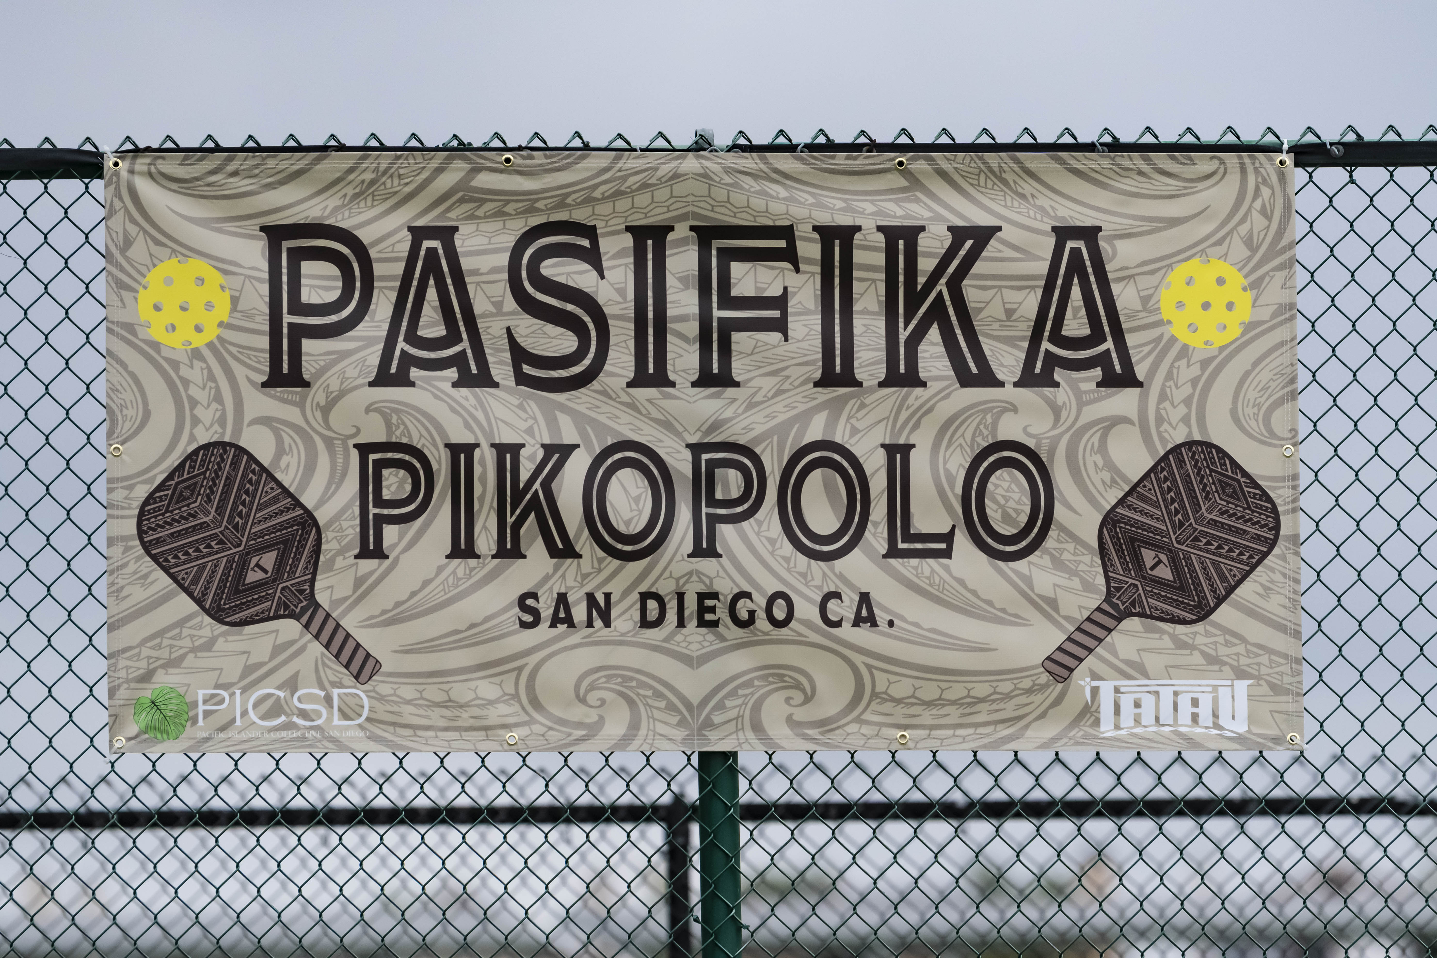
PASIFIKA PIKOPOLO
Welcome to Pasifika Pikopolo, where our mission is to promote the physical health and well-being of Melanesian, Micronesian, and Polynesian communities through the engaging and dynamic sport of PIKOPOLO (pickleball).
TATAU BRAND & Pacific Islander Collective San Diego (PICSD) believe in the power of an active lifestyle to enhance overall health, foster social connections, and promote community spirit. TATAU BRAND & PICSD strive to create a positive impact on our Pacific Islander communities through pickleball.
Together, we will uplift each other by building a supportive environment that encourages everyone to participate, get active, and enjoy benefits of PIKOPOLO!

Slide 3
2nd Annual Pasifika Pikopolo Tournament 2026
Community • Fitness • Fun
Date: Saturday, June 27, 2026
Location: Melba Bishop Pickleball Courts, Oceanside, CA
Hosted by: TATAU BRAND and Pacific Islander Collective San Diego (PICSD)
Contact info: info@PasifikaPikopolo.com

Slide 4
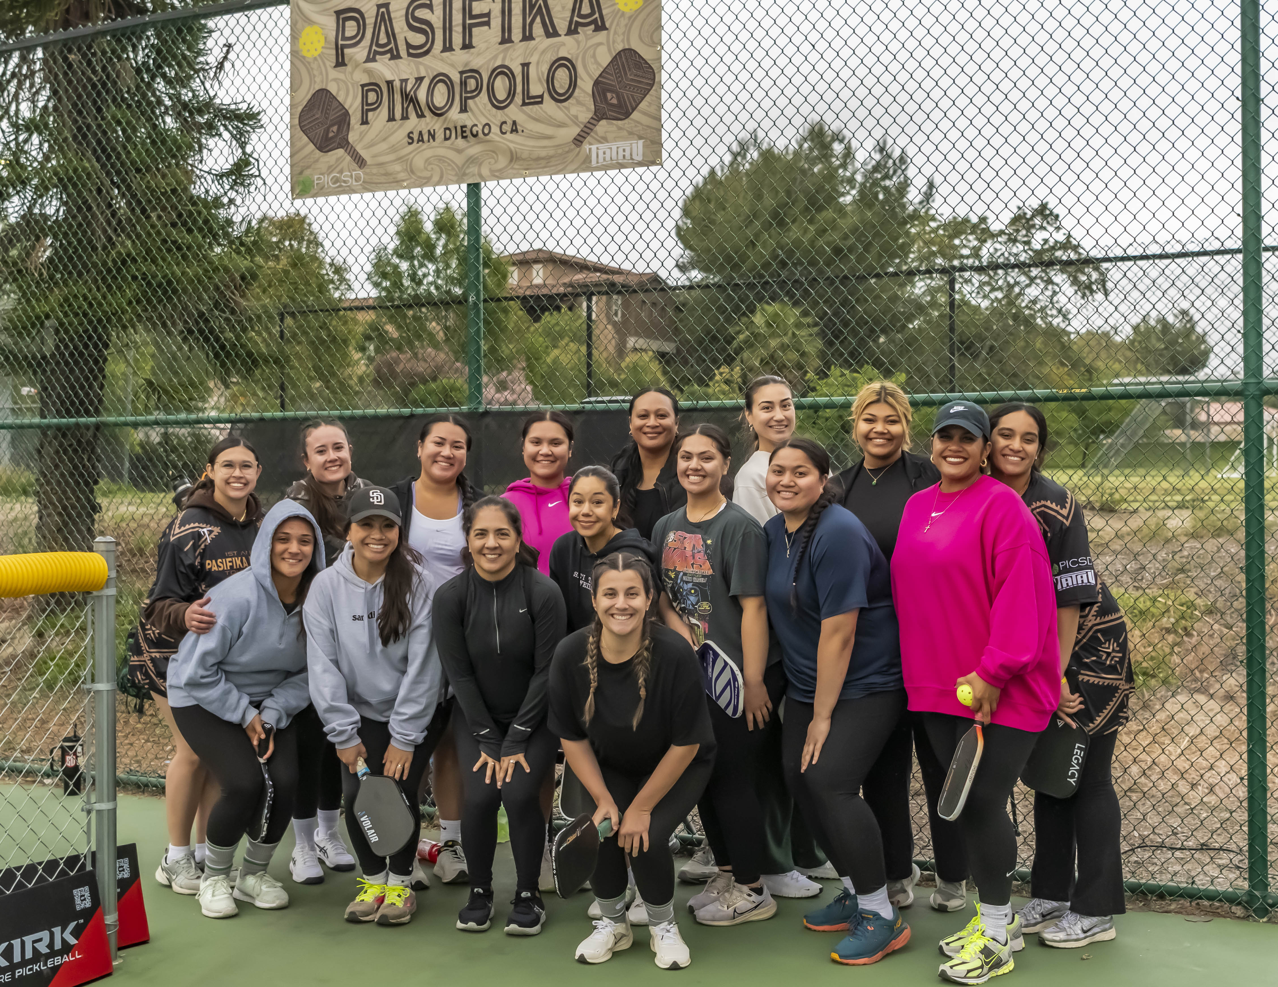
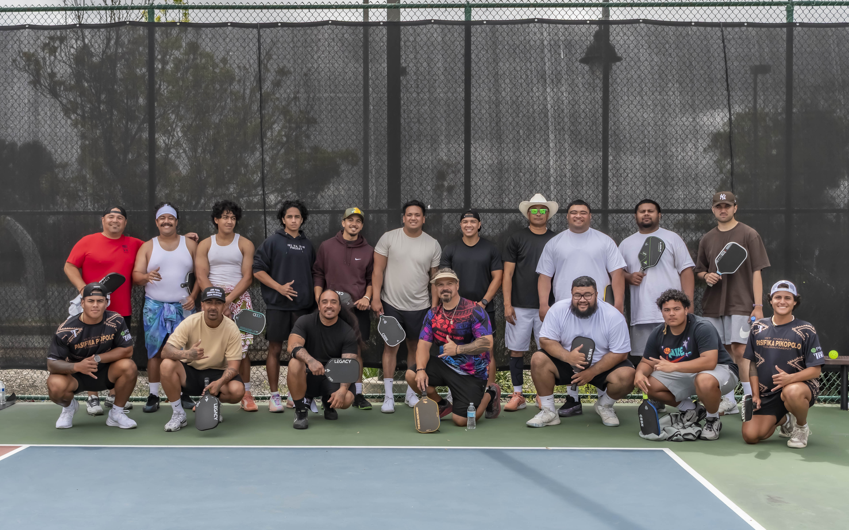
Why Sponsor this Event?
Your Brand + Community Impact
Reach not a “Hard to reach” but a “Hardly reached” community
Visibility in a local, active, and family-friendly audience
Positive brand association with health and recreation
Affordable marketing with high visibility
Support community sports and social connection

Slide 5

Who You’ll Reach
Players: ages Youth to Elders
Spectators: families, friends, and community members
Exposure through:
Social media
Event signage
On-site announcements
“Coconut Wireless” Word-of-mouth

Slide 6
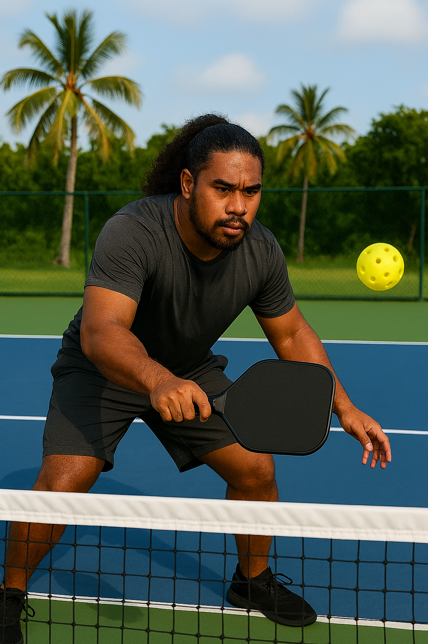
DINK $500 Sponsorship Great Entry-Level Visibility
Logo on event banner (shared placement)
Logo on event website & social media posts
Verbal thank-you during opening or closing announcements

Slide 7

DROP $1,000 Sponsorship Enhanced Brand Exposure
Includes all DINK benefits, plus:
Larger logo placement on event banner
1 dedicated social media post highlighting your business
Option to include promotional items in player swag bags

Slide 8
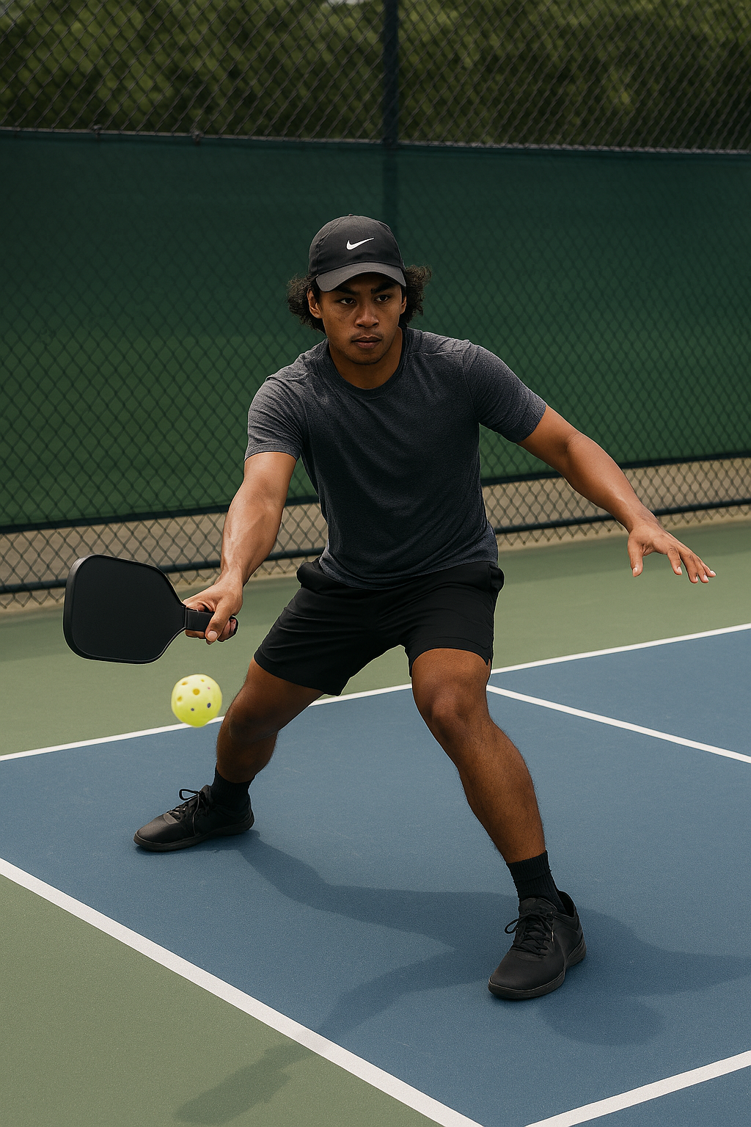
DRIVE $1,500 Sponsorship Premier Event Partners
Includes all DROP benefits, plus:
Top logo placement on all event materials
Multiple verbal mentions throughout the event
Opportunity to sponsor a court (signage included)
Featured spotlight on social media before and after the event

Slide 9
In-Kind Sponsorship
By offering in-kind support, sponsors can provide essential resources that directly contribute to the success of our Pasifika Pikopolo Tournament. We are happy to accept in-kind sponsorships in the form of goods, services, or expertise. Please reach out to our contact below to discuss this sponsorship opportunity.
Contact info: info@PasifikaPikopolo

Slide 10

Next Steps
Choose a sponsorship level
Submit logo and brand materials
Enjoy tournament day visibility and community impact!
Contact us at info@PasifikaPikopolo with:
Name: Email: Phone:
Sponsorship Level:

Slide 11
Thank You for Supporting PASIFIKA PIKOPOLO Community!

